Slide 1
What is a number?
In ordinary English, the word "number" has two different meanings.
One meaning is the concept of a number.
The other meaning is how the concept is represented.
Think about what is:
"the number of eggs in an egg carton"

Slide 2
Representations
What you thought is a representation of the number. These are all different representations of the same number:
XII
///// ///// //
12
twelve
1100₂

Slide 3
Computer Representation
Computer Science is concerned with using patterns of bits to represent things.
It is important to be clear about the difference between the thing, and a representation of the thing.
For example, an integer may be represented using a bit pattern in computer memory. (There are many different ways to do this.)
The integer is conceptual.
The bit pattern is only a representation of the concept.

Slide 4
Decimal Representation
A number system is a way of representing numeric values
The familiar decimal, or base-10, representation has been in use for over 1000 years, having been developed in India, improved by Arab mathematicians in the 12th century, and brought to the West in the 13th century by the Italian mathematician Leonardo Pisano (c. 1170 – c. 1250), better known as Fibonacci.
Using decimal notation is natural for ten-fingered humans, but binary values work better when building machines that store and process information.

Slide 5

Integer (Whole) Number
An integer is a number that can be written without a fractional component.
For example, 21, 4, 0, and −2048 are integers, while 9.75, 5 1/2, and √2 are not.
denotes the set of all integers

Slide 6
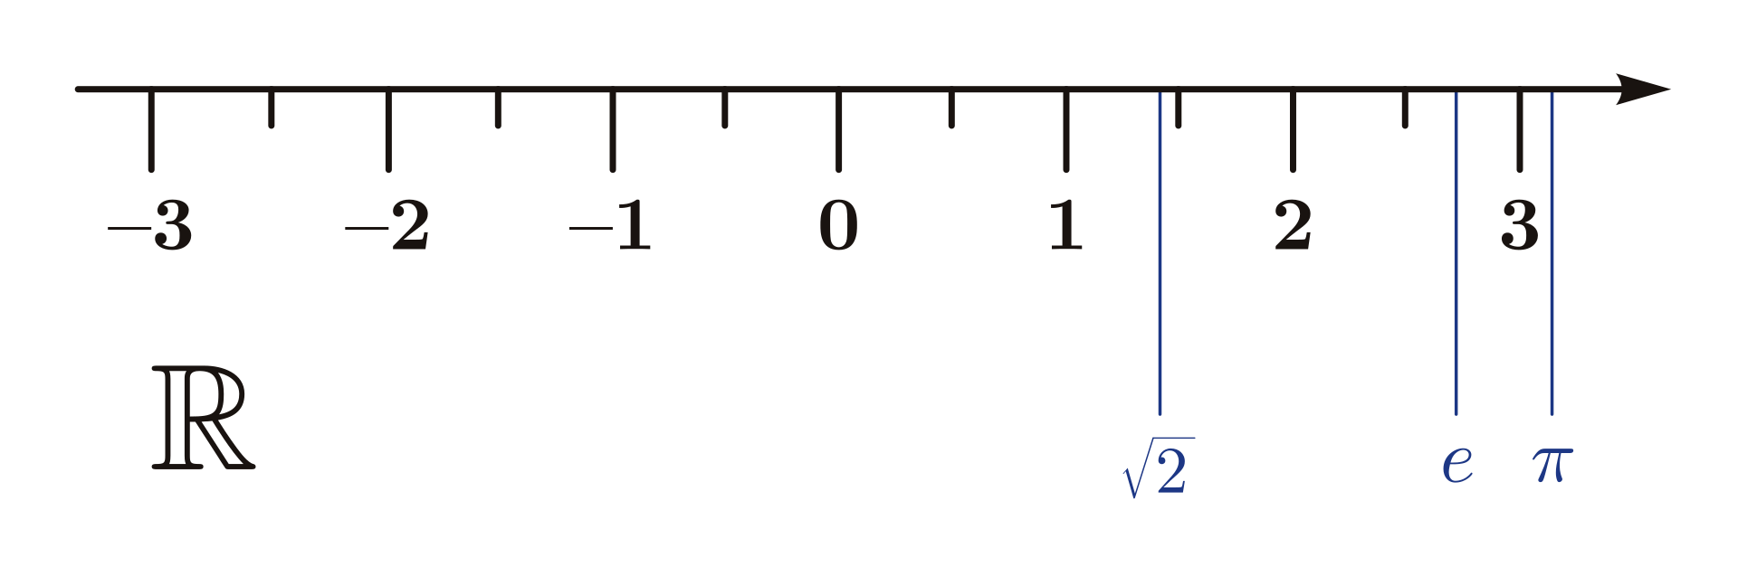

Real (Continuous) Number
A real number is a value of a continuous quantity.
The real numbers include all the rational numbers, such as the integer −5 and the fraction 4/3, and all the irrational numbers, such as √2 (1.41421356
Examples, 21.0, 9.75, 5 1/2, and √2
denotes the set of all real numbers
Real numbers can be thought of as points on an infinitely long number line

Slide 7
Positional Notation
The decimal system is a positional notation for representing numbers. This means that the representation consists of a string of digits. The position of each digit in the string is significant. Think of each position as a numbered slot where a digit can go.
____₄ ____₃ ____₂ ____₁ ____₀
Positional notation has many advantages. It is compact: "78" is shorter than "LXXIIX". Computation is easy. LXXIIX times XLIIV is hard to do using the Roman system.

Slide 8
Decimal Notation
7305 = 7 × 10³ + 3 × 10² + 0 × 10¹ + 5 × 10⁰
For base 10 representation (often called decimal representation), the rules of positional notation are:
The base is 10.
There are 10 digits: 0, 1, 2, 3, 4, 5, 6, 7, 8, 9 .
Positions correspond to integer powers of 10, starting with power 0 at the rightmost digit, and increasing right to left.
The digit placed at a position shows how many times that power of 10 is included in the number.

Slide 9
Rules for Positional Notation
The base B is (usually) a positive integer.
There are B "digits" representing zero up to (B minus one).
Positions correspond to integer powers of B, starting with power zero, and increasing right to left.
The digit placed at a position shows how many times that power of B is included in the number.
Fill in the blanks with the appropriate power of 10:
7305 = 7 × 10___ + 3 × 10___ + 0 × 10___ + 5 × 10___

Slide 10
Radix
Radix or base is the number of unique digits, including the digit zero, used to represent numbers in a positional numeral system.

Slide 11
Number systems common in IT
Decimal (base 10)
Digits: 0, 1, 2, 3, 4, 5, 6, 7, 8, 9
Binary (base 2)
Digits: 0, 1
Hexadecimal (base 16)
Digits: 0, 1, 2, 3, 4, 5, 6, 7, 8, 9, A, B, C, D, E, F
Octal (base 8)
Digits: 0, 1, 2, 3, 4, 5, 6, 7

Slide 12
Binary, hexadecimal and octal
Computers use binary
Unwieldy for humans
Humans prefer decimal
Unsuitable for computers
Hexadecimal (hex) and octal are good compromises
Since these bases are powers of 2, easily converted to and from binary
Counting, arithmetic and conversions to decimal use same mechanics as any other base

Slide 13
First twenty numbers in each system
Concept | Decimal | Binary | Hex | Octal
 | 0 | 0 | 0 | 0
* | 1 | 1 | 1 | 1
** | 2 | 10 | 2 | 2
*** | 3 | 11 | 3 | 3
**** | 4 | 100 | 4 | 4
***** | 5 | 101 | 5 | 5
***** * | 6 | 110 | 6 | 6
***** ** | 7 | 111 | 7 | 7
***** *** | 8 | 1000 | 8 | 10
***** **** | 9 | 1001 | 9 | 11
***** ***** | 10 | 1010 | A | 12
***** ***** * | 11 | 1011 | B | 13
***** ***** ** | 12 | 1100 | C | 14
***** ***** *** | 13 | 1101 | D | 15
***** ***** **** | 14 | 1110 | E | 16
***** ***** ***** | 15 | 1111 | F | 17
***** ***** ***** * | 16 | 10000 | 10 | 20
***** ***** ***** ** | 17 | 10001 | 11 | 21
***** ***** ***** *** | 18 | 10010 | 12 | 22
***** ***** ***** **** | 19 | 10011 | 13 | 23
***** ***** ***** ***** | 20 | 10100 | 14 | 24

Slide 14
Positional Representation Conversion Types
Binary -> Decimal
Decimal -> Binary (Hex or Octal)
Binary -> Octal or Hex
Octal or Hex -> Binary

Slide 15
Case 1. Binary to Decimal
Convert 101101₂ to decimal:
Calculate the weighted position
Multiply each weight times the digit
Sum the values
1 x 2⁵ + 0 x 2⁴ + 1 x 2³ + 1 x 2² + 0 x 2¹ + 1 x 2⁰
1 x 32 + 0 x 16 + 1 x 8 + 1 x 4 + 0 x 2 + 1 x 1 = 45₁₀

Slide 16
Decimal to Binary (Division Remainder)
Convert 147₁₀ to binary:
Divide 2 into 147 = 73 rem 1
Divide 2 into 73 = 36 rem 1
Divide 2 into 36 = 18 rem 0
Divide 2 into 18 = 9 rem 0
Divide 2 into 9 = 4 rem 1
Divide 2 into 4 = 2 rem 0
Divide 2 into 2 = 1 rem 0
Divide 2 into 1 = 0 rem 1
Read remainders bottom to top = 10010011₂

Slide 17
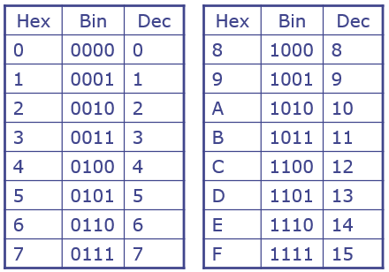
Binary-hexadecimal conversions
16 = 24, so each hex digit matches exactly four binary digits
Binary to hex is a simple 1 for 4 substitution
Working right to left, break binary value into 4-bit chunks
Add leading 0s as needed
Substitute appropriate hex digit for each 4-bit chunk
Hex to binary is a simple 4 for 1 substitution
0100 | 0010 | 1111
4 | 2 | F
3 | 9 | A
0011 | 1001 | 1010

Slide 18
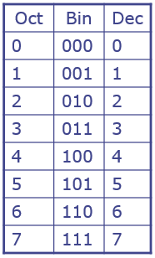
Binary-octal conversions
8 = 23, so each octal digit matches exactly three binary digits
Binary to octal is a simple 1 for 3 substitution
Working right to left, break binary value into 3-bit chunks
Add leading 0s as needed
Substitute appropriate octal digit for each 3-bit chunk
Octal to binary is a simple 3 for 1 substitution
010 | 000 | 101 | 111
2 | 0 | 5 | 7
1 | 6 | 3 | 2
001 | 110 | 011 | 010

Slide 19
Pattern Names - Hexadecimal
Consider the following pattern. It is not easy for people to work with.
0010100010101010
It is convenient to break bit patterns into 4-bit groups (called nibbles):
0010 1000 1010 1010
There are 16 ( 2⁴ ) possible patterns in a nibble.
Bits are grouped into nibbles starting at the right.
Each nibble is given a hex digit
This method of giving names to patterns is called hexadecimal
0010 1000 1010 1100 = 28AC

Slide 20
Pattern Names - Octal
Sometimes documentation describes bit patterns in groups of three called octal notation.
A bit pattern can be named using hexadecimal or octal
01101010 = 01 101 010 = 152 (octal) 01101010 = 0110 1010 = 0x6A (hex)
Octal is awkward to use with 8-bit bytes. Bytes don't evenly split into octal pattern names. Historically, some computer documentation used octal pattern names. Also, in several programming languages (C and Java among them) octal notation is indicated by a leading zero:
0152 (octal) = 001 101 010 0x152 (hex) = 0001 0101 0010 152 (decimal) = 1001 1000
When the number of bits is not a multiple of three it is conventional to add zero bits to the left, and then to name the pattern as usual.

Slide 21
Fractions
Fractional values do not always have exact equivalents in all bases
Forced to settle for approximations
Radix points are used when representing fractions
Weights to left of radix point are positive powers of the base
Moving radix point one digit to the right multiplies the value by the base (37.34 373.4)
Weights to right of radix point are negative powers of the base
1/10, 1/100, 1/1000, etc. in decimal
1/2, 1/4, 1/8, 1/16, etc. in binary
Moving radix point one digit to the left divides the value by the base (373.4 37.34)

Slide 22
Some fractional examples (base to decimal)
.823₁₀ = 8 x 10⁻¹ + 2 x 10⁻² + 3 x 10⁻³
8 x 1/10 + 2 x 1/100 + 3 x 1/1000
.8 + .02 + .003 = .823₁₀
.1011₂ = 1 x 2⁻¹ + 0 x 2⁻² + 1 x 2⁻³ + 1 x 2⁻⁴
1 x 1/2 + 1 x 1/8 + 1 x 1/16
1 x .5 + 1 x .125 + 1 x .0625
.5 + .125 + .0625 = .6875₁₀
Try .A3E₁₆ to decimal

Slide 23
Answer
.A3E₁₆ = 10 x 16⁻¹ + 3 x 16⁻² + 14 x 16⁻³
10 x 1/16 + 3 x 1/256 + 14 x 1/4096
10 x .0625 + 3 x .00390625 + 14 x .000244140625
.625 + .01171875 + .00341796875 = .64013671875₁₀

Slide 24
Converting fractions to other bases
Multiply number being converted by desired base,
Noting digit that moves to left of radix point; record that as next digit in answer (working left to right)
Repeat using fractional part until it’s 0 or desired accuracy achieved

Slide 25
Example converting decimal to other base
Convert .393₁₀ to binary with six places: .393 x 2 = 0.786: answer so far: .0₂ .786 x 2 = 1.572: answer so far: .01₂ .572 x 2 = 1.144: answer so far: .011₂ .144 x 2 = 0.288: answer so far: .0110₂ .288 x 2 = 0.576: answer so far: .01100₂ .576 x 2 = 1.152: answer so far: .011001₂ That’s six places, so the final answer is: .011001₂

Slide 26
Working with mixed numbers
Conversions done in two stages
Convert integer part
Convert fractional part
Combine results, keeping radix point between them
10.102_10 -> base 2. 10 -> 1010
.102 x 2 ->.204 -> .0
.204 x 2 -> .408 -> .00
.408 x 2 -> .000
1010.0001

Slide 27
10.5_10 -> 2
1010.
.5 x 2 -> 1.0
0 x 2
1010.1

Slide 28
Review Questions
How many patterns can be formed with 10 bits?
Change the representation of 10110111₂ to decimal?
Change the representation F3B09₁₆ to base 10?

Slide 29
Starter Answers
How many patterns can be formed with 10 bits? 1024

Slide 30
Starter Answers
Change the representation of 10110111₂ to decimal?
1 x 2⁷ + 0 x 2⁶ + 1 x 2⁵ + 1 x 2⁴ + 0 x 2³ + 1 x 2² + 1 x 2¹ + 1 x 2⁰
128 + 0 + 32 + 16 + 0 + 4 + 2 + 1 = 183₁₀
Change the representation F3B09₁₆ to base 10?
15 x 16⁴ + 3 x 16³ + 11 x 16² + 0 x 16¹ + 9 x 16⁰
15 x 65536 + 3 x 4096 + 11 x 256 + 0 x 16 + 9 x 1
983,040 + 12,288 + 2,816 + 0 + 9 = 998153₁₀

Slide 31
Binary-coded decimal (BCD)
Another way of representing numbers in binary
4-bits per decimal digit
6 unused patterns – can be used for signs, etc.
Less space efficient, more computationally complex
Simpler to convert from text
Favors I/O over calculation
Can be used with fixed decimal
Important and continue to be used in financial, commercial, and industrial computing, where subtle conversion and fractional rounding errors that are inherent in floating point binary representations cannot be tolerated

Slide 32
BCD Binary Representation
Dec | BCD
0 | 0000
1 | 0001
2 | 0010
3 | 0011
4 | 0100
5 | 0101
6 | 0110
7 | 0111
8 | 1000
9 | 1001
Many different representations with various levels of complexity https://en.wikipedia.org/wiki/Binary-coded_decimal
BCD takes advantage of the fact that any one decimal numeral can be represented by a four bit pattern. The most obvious way of encoding digits is Natural BCD (NBCD), where each decimal digit is represented by its corresponding four-bit binary value, as shown in the following table. This is also called "8421" encoding

Slide 33
BCD Practice
83256_10 ->
8 3 2 5 6
1000 0011 0010 0101 0110
This is different than base 2 representation of binary which would be
537174_10 for that bit pattern. BCD and base 2 representation are almost always different

